Slide 1
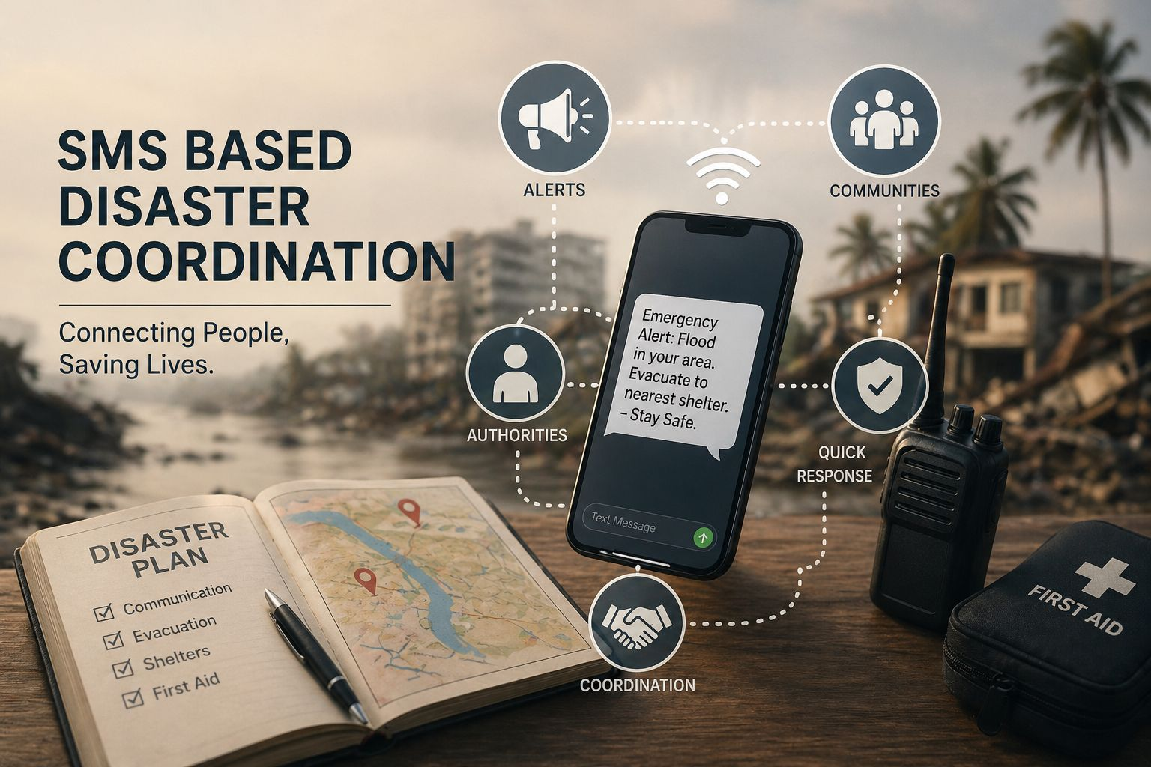
SMS BASED DISASTER COORDINATION
BY TEAM : MERAKI
Notes:
NOTE:
To change the image on this slide, select the picture and delete it. Then click the Pictures icon in the placeholder to insert your own image.

Slide 2
Contents
Abstract
Introduction
Problem Statement
Solution
Tools and Technologies
Working
Features and Advantages
Conclusion

Slide 3
Abstract
ResQLink is an offline-first emergency communication system designed for disaster situations where internet connectivity is unavailable. It integrates multiple communication channels such as SMS simulation, mesh networking, and local beacon portals to ensure that emergency requests reach responders efficiently. The system collects, processes, and displays requests in a unified dashboard, enabling quick decision-making and coordination. By using local storage and smart routing, ResQLink ensures reliable, real-time communication during critical situations

Slide 4
Introduction
During natural disasters like floods, earthquakes, or cyclones, communication networks often fail, making it difficult for people to request help. Traditional systems depend heavily on the internet, which limits their effectiveness in such scenarios. ResQLink is designed to overcome this issue by providing a decentralized and offline-capable communication system. It allows users to send emergency requests through different channels and ensures that responders receive and act on them quickly.

Slide 5
Problem Statement
In disaster situations such as floods, earthquakes, and cyclones, communication infrastructure is often severely damaged or completely unavailable. This creates a critical gap between affected individuals and emergency responders. People are unable to send distress signals, and even when they do, there is no guarantee that the message will reach the right authority on time.
Internet and mobile networks may be unavailable
Emergency requests may not reach authorities on time
Lack of coordination between rescue teams
No unified system to manage multiple communication sources

Slide 6
Solution
ResQLink provides a multi-channel emergency communication system that works without internet dependency. It can :
Accept requests via SMS simulation, mesh network, and beacon portal
Automatically categorizes and assigns tasks to appropriate teams
Stores and synchronizes data locally
Displays all requests in a unified command center
This ensures faster response, better coordination, and efficient disaster management.
LINK : https://ideathon-eight-ruddy.vercel.app/

Slide 7
Tools and Technologies
This slide presents the technologies used to build the system. HTML, CSS, and JavaScript are used for frontend development to create the user interface and make it interactive. LocalStorage acts as a simple backend storage within the browser, allowing data to be saved even without an internet connection. Asynchronous JavaScript is used to handle multiple tasks efficiently and simulate mesh network communication for real-time message flow. UI/UX design ensures the dashboard is user-friendly, clear, and easy to navigate, especially during emergencies. Finally, the browser environment along with Node.js helps in integrating all components, enabling smooth functioning of the entire system
HTML, CSS, JavaScript – Frontend development
LocalStorage – Backend storage
Async JavaScript – For mesh network simulation
UI/UX Design – For interactive dashboards
Browser Environment – Node.js : For system integration

Slide 8
WORKING
SMS Dashboard
1. User sends a message (e.g., “HELP MEDICAL”).
2. System detects keywords and assigns a team
3. Request is stored and displayed instantly
Mesh Network Simulator
1. Message travels through nodes step-by-step
2. Visual animations show data movement
3. Final responder receives and processes the request.
Beacon Portal
1. User connects to a local zone
2. Fills structured form
3. Request is directly mapped to a team
Unified Dashboard
1. Collects data from all modules
2. Normalizes and displays requests
3.Provides filtering, search, and status tracking

Slide 9
Features and Advantages
Works completely offline
Supports multiple communication channels
Automatic team assignment
Real-time data synchronization
Easy-to-use interface
Improves response time and coordination

Slide 10
Conclusion
ResQLink is a reliable and efficient solution for emergency communication in disaster scenarios. By eliminating dependency on the internet and integrating multiple communication methods, it ensures that help requests are delivered and managed effectively. The system enhances coordination among rescue teams and can significantly reduce response time, ultimately saving lives.

Slide 11
THANK
YOU

